Slide 1
Finding the Right Postdoc
Pat Phelps, PhD
Director Professional Development and Career Office
elps, PhD
Director, Professional Development and Career Office

Slide 2
THE POSTDOC
The Postdoc period can be a phenomenal time in your life when you can really figure it all out, What is it that excites you about science? Graduate school is about learning how to be a scientist. The Postdoc is about laying the foundation for the rest of your career.
Jeremy Reiter, MD PhD Assistant Professor Biochemistry, UCSF
Notes:
Deciding whether or not to do a postdoc and where to do a postdoc is a critical decision in your career path. This decision should be done thoughtfully. It should be a well-informed decision.
Dr. Jeremy Reiter summed it up nicely by stating:

Slide 3
WHEN SHOULD YOU START LOOKING?
Notes:
When should you start looking for a postdoc? A good rule of thumb is 1 year before you hope to start your new postdoc position. Highly desirable labs may have a one to two year waiting period depending on size limitations and funding. Government postdocs may have long higher processes and timing may depend on their annual budget cycle. The worst scenario is to start too late which could limit your options. It is also important not to start applying before you have submitted a publication and have a body of research to share. With that said, it is never too early to
start thinking about what research topic, field, institution, country, lab you may want to investigate for postdoc opportunities.

Slide 4
Its hard to think about your next career step and your career goals when you are overwhelmed with research, writing papers, edits, grant writing etc.
Notes:
The key message is to plan ahead. Thinking about your next career step in the midst of finishing up papers or defending your thesis is not the best timing and can lead to more stress and poor decisions

Slide 5
AVOID THE “DEFAULT” POSTDOC WITH AN INTERNSHIP
All JHU PhD students are eligible for internships through the Biomedical Careers Initiative
Typically ~3 months
PAID (and includes health insurance)
Available summer, fall, and spring
Part-time and full-time
Contact Caroline Pounds or visit http://bci.jhmi.edu/Internships for more information
Notes:
If you are viewing this presentation and are less than six months away from graduating and have not yet thought about your next career step or where you would want to do a postdoc, an excellent opportunity is to do an internship in industry, technology, patent law or science policy and communication after your defense but before you officially graduate. Internship experiences can build skills relevant to both academic and nonacademic careers and allow time for a more intentional postdoc search after the stress of completing your dissertation is over. Internships can also provide insights into whether you want to enter the job market and skip the postdoc or what career you might enjoy after completing your postdoc.

Slide 6
PARTICIPATE IN POSTDOCTORAL HIRING INTERVIEWS
What did they do well that you would want to emulate?
Notes:
One recommendation is to engage fully in any interviews for new postdoctoral fellows for your lab or your department. Pay attention to how they answered interview questions and what questions your PI and your colleagues are asking. What aspects of their research presentation helped them stand out as a candidate and what parts could be improved. Engage in conversations with your PI and other faculty mentors about how they choose which postdocs to interview and what factors influence their decision on which candidate to hire.

Slide 7
DEVELOP LIST OF POTENTIAL PIs
Seek advise from your PI and committee members.
Engage with seminar speakers who visit Johns Hopkins or local universities.
Connect with potential PIs at conferences or when they visit Johns Hopkins for seminars. Observe their interactions, is the PI introducing their lab members at conferences? How do they interact with trainees asking questions at seminars or conferences?
Invite a PI of interest to to give a seminar in your department.
Read literature in fields of interest and list PIs whose work excites you.
If you are interested in a non academic institution, whether government or industry, speak with their Postdoctoral Fellows office and ask which researchers are working in your area of interest. Share your interest in engaging in a postdoc at their institution.
Tip: Schedule evaluation of at least one PI a month on your calendar.
Notes:
The first step is to develop a list of PIs you might want to postdoc with. Ask your PI and other faculty mentors for recommendations. See which names keep popping up. Networking with seminar speakers who visit campus, not just about their research but also about their institution, may open doors. Attending conferences during the last year of your PhD is critical for promoting your science and meeting potential Postdoc mentors. Observe how PIs engage with other scientists and also how they interact with their current lab members. Are they introducing their trainees to other scientists? Conferences are also a great opportunity to ask lab members who work for a potential PI questions about their research and interaction with their mentor. If you are interested in a government organization or a industry postdoc program, you can reach out to the Director of the Postdoctoral Fellows program and seek input about PIs working in your area of research and names of Postdocs you can conduct informational interviews with to find out more about the postdoc culture at that company or organization.

Slide 8
WHAT IS YOUR CAREER GOAL?
ACADEMIC RESEARCH CAREER Project that will yield independent research Opportunity for high impact paper K Award mentorship | ACADEMIC TEACHING CAREER Research that engages undergraduates Affordable model system Teaching opportunities Pedagogy training
BIOTECH/PHARMA Translational project Industry relevant skills Location near biotech hub PI with industry ties Project amenable to industry collaborations or partnership | UNDECIDED Project that will yeild independent research University with excellent Postdoctoral Association and career support
Notes:
It is advisable to think about your career goal when selecting a postdoc. If you know you want an academic research career it will be critical to identify a project that will yield independent research and join a lab with an excellent history of publication productivity and alumni who have transitioned into academic positions. Finding a mentor who will support your funding applications, especially a K Award is advised. If you are interested in an academic teaching position you will want to select a model organism or research area that is affordable and easy to engage undergraduates into your research program. If you are interested in biotech, seek out a translational project with industry relevant skills. Look through job ads to identify what the HOT techniques and skills are at the companies you are interested in working with. Seek a PI with industry ties whether they have started their own company, serve on an industry advisory board or have collaborations with industry partners. Selecting a city in or near a biotech hub is also advised. This will allow ample networking opportunities with industry professionals. If you are undecided about your future career, select an institution with a robust career and professional development program.

Slide 9
WHY DO YOU WANT A POSTDOC?
Are you getting a postdoc to develop new skills?
Is your main goal to publish?
Are you getting a postdoc to further develop existing skills?
Do you want to stay in academia or are you also considering industry?
Do you want to focus on research, teaching or a combination?
Do you need grant writing support?
Notes:
It is also important to think about what you need to achieve in your postdoc. Do you need to publish, demonstrate ability to get funding or gain teaching experience?

Slide 10
FINDING THE RIGHT LAB
PERSONAL PREFERENCES Small or large lab Quality of life – weather, cost of living Opportunities to mentor students Lab environment – structured or unstructured Hands-on or Hands-off mentor | GROWTH New model system but same field New field but same model system New research focus, e.g. bioinformatics versus wet lab New research area that uses current skills
RESEARCH PROJECT Well developed model system – great way to conduct sophisticated research but field can be competitive Will your PI be a competitor Will project lead to independent line of research Does the project lend itself to funding through NIH or foundations? | LAB Career outcomes of alumni Publication record Funding record and current status Lab meeting frequency | culture Collaborative or competitive Seniority of lab members Technical support
Who will actually be training you, a lab manager, the PI or senior postdoc?
Notes:
When choosing a lab there are multiple factors to consider. Start by thinking about why you chose your current lab and what you like and do not prefer about your current lab. Don’t underestimate your personal needs. Having a good quality of life will improve research productivity. It is critical for funding and your career that you pick a lab where you can grow your expertise and skill set. If you are interested in an academic research career, it is important to pick a project that can transition into an independent line of research. If you are interested in industry, you might want to pick a project that is highly collaborative. Last but not least, what is the lab environment like and who will actually be training you, the PI or a senor postdoctoral fellow?

Slide 11
FAMOUS PI
Cons
Competitive
May not be good mentor
Pros
Funding
Good project
Good career prospects due to success by association and contacts you will get
Enhanced grant success due to PI
High impact publication potential
Notes:
There are pros and cons of working for a famous PI. Make sure it is the right fit and investigate where their lab alumni are?

Slide 12
FINDING POSITIONS
Ask PI and committee members for recommendations and connections
Network at conferences, meetings
Science journals and scientific societies
Institution websites, departmental websites, PI websites
Search engines: Biospace, LinkedIn, Indeed.com, Postdoc.jobs.com, findapostdoc.com, Handshake
Twitter: #postdoc, #postdocjobs, @postdocjobs
Notes:
When looking for positions in addition to seeking advice from your mentor and networking at conferences, search engines, scientific societies and twitter are excellent resources.

Slide 13
Cover Letter or Email Try and have someone introduce you
Put who referred you in email subject if not direct introduction
Who you are – what you want – a postdoc
Why are you interested in their lab – be specific. Suggest projects you might be able to contribute to and how you could be of use to the lab. Why you fit – this is most important part! Discuss that you have read their science and why it is interesting to you.
Lab you did you graduate work in
How you know the person
When will you finish PhD
BRIEF description of your research to date
Highlight major publications
Attach CV and PDFs of major publications
Notes:
The ideal scenario for contacting a PI or about a postdoc opportunity is to be introduced by your PI or faculty mentor. Including a common contact’s name in the subject line is advised – e.g. Professor x PhD student seeking postdoc. Faculty get 200 emails a week about postdoctoral positions, therefore your email needs to stand out. The most important factor is to demonstrate interest in their research, why you want to work with them, what skills you can bring to their lab and where you see yourself fitting into their current body of work. Most PIs are seeking a PhD who can problem solve and think critically. They are also seeking a PhD who has accomplished a significant body of work and can communicate why it is important to the field. One common myth is a postdoc needs to have the skills used in the lab. The postdoc is a training position and PIs do not expect you to have all the skills required for the proposed project. They are more than willing to train you.

Slide 14
Preparing for Interview
Practice Practice Practice job talk
Research lab’s current and past work
Think about the type of project you want to work on, what you bring to lab, your expectations from the postdoc
Dress to impress – this is a job interview
Prepare list of questions to ask PI, lab
Take time to visit area, walk around institution
Notes:
The best advice for your interview if to prepare and practice. Interviewing is a skill therefore if you have multiple interviews, schedule the interview you are least interested in first and the interview you are most interested in last.

Slide 15
Postdoc Interview Expect a full day of interviewing
Job Talk about your research – one hour
Meet with PI
Meet with other faculty members
Meet with lab members
Tour university, local area, lab facilities
Lab members have a significant influence on who is hired – every conversation
is part of the interview process
Notes:
The interview will include conversations with the lab members, a one on one with the PI, a presentation on your research and potentially meetings with other faculty or researchers. Everyone, even the assistant who arranged your travel, can have a voice in the hiring decision. Engage respectfully and professionally at all points along the interview process

Slide 16
QUESTIONS TO ASK
What are the adviser's expectations of the postdoc?
Is the PI well connected? Can they introduce me to the right people?
Will the adviser or the postdoc determine the research program?
How many postdocs has this adviser had? Where did they go afterward?
What do current and past lab members think about their experience?
Will the adviser have time for mentoring? Or should I seek out other mentors?
How many others (grad students, staff, postdocs) now work for this adviser?
How many papers are being published? Where? Publication record?
What is the adviser's policy on travel to meetings? Authorship? Ownership of ideas?
Will I have practice in grant writing? Teaching/mentoring? Oral presentations? Review of manuscripts?
Can I expect to take part of the project away after the postdoc?
How long is financial support guaranteed? On what does renewal depend?
Can I count on help in finding an academic position?
Will the adviser have adequate research funds to support the proposed research? Is the lab well funded? Is there space to work? Solid grant record?
Is the mentor’s lab a good fit? Is the lab 9 to 5 or working 24/7? Small or large lab? Technician or lab manager available for support? Collaborative or competitive?
Does the PI have tenure? Do they serve on study sections?
What facilities and resources do you have access to?
Will the project yield interesting and publishable results?
Notes:
Here is a list of some questions to answer for each lab. If you are interviewing at multiple labs, I suggest you start a spreadsheet or rubric that defines and prioritizes what you are seeking. This can help take the emotion out of the process.

Slide 17
Choosing the right PI
Notes:
This is a nice quote about what to look for in a postdoc mentor. What is important to you?

Slide 18
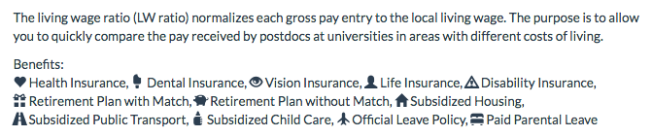
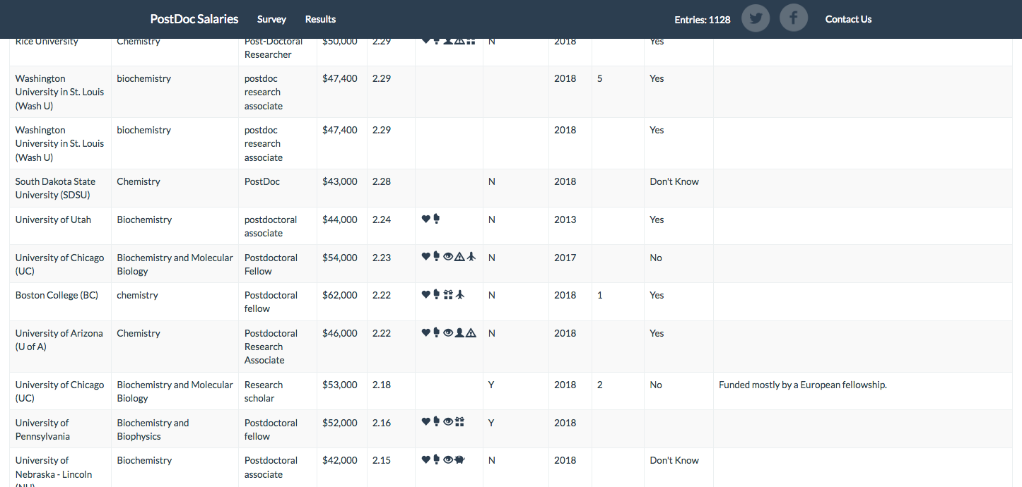
How much does a postdoc actually make?
>1,100 postdoc salaries reported at: https://postdocsalaries.appspot.com/
Notes:
Not all postdocs pay the same salary or provide the same benefits. Pay and benefits can vary within the same institution. Industry and many specialized fellowships offer salaries between $70K and $90K depending upon experience and cost of living. You can search actual self-reported salaries of postdocs across the county using this website. You can negotiate postdoc salary and benefits. The PI may not be able to offer any additional salary or benefits, but you can ask, especially if you have multiple offers. If not salary, you can negotiate travel funds.

Slide 19
INDUSTRY POSTDOCS
Gives you exposure to biotech/pharma
Provides experience/foot in the door
You can go back to academia – this can be dependent on what company you choose
Many companies like to continue the relationship with postdocs in their faculty positions
You can publish
Resource rich
Notes:
We get a lot of questions about industry postdocs. Can you transition back into academia after an industry postdoc? Does an industry postdoc guarantee you a job at that company? Will I be able to publish? The answers depend on what company that your postdoc is at. The Novartis postdoc program is designed to prepare you for academia in the hopes you will be a future collaborator. Janssen is seeking to recruit permanent talent from their postdoc program. It is always advisable to review the career outcomes of any postdoc program. If you are interested in publishing and keeping the door open for an academic position, it is better to postdoc at a larger company with a well-established postdoc program. If you know you are interested in a career in industry, you can gain more skills or wear more hats at a smaller company, especially a start-up.

Slide 20
Industry Postdocs
Genetech
Pfizer
Medimmune
Astra Zeneca
Novartis
Amgen
J & J
Biogen
Eli Lilly
Celgene
New England Biolabs
Sutro Biopharma
Achaogen
GSK
Abbvie
Merck
Sanofi
Biogen
Shire
Regeneron
Alexion
Roche
Alkermes
Mircosoft
NGM
Dynavax
Wolfe laboratories
Notes:
Here is a list of some companies that offer postdoctoral positions.

Slide 21
NON-DEGREE GRANTING INSTITUTIONS
FDA
NIH
St. Jude
ORISE fellowships at National Labs
Jackson Labs
Max Planck, Beckman Research Institute, HHMI, CDC, Smithsonian, and Scripps Research Institute
Notes:
Here is a list of non-degrees granting institutions that offer postdoctoral positions.

Slide 22
NON-TRADITIONAL POSTDOCTORAL FELLOWSHIPS
Cornell Runway Start-Up Postdoc for Entrepreneurs
FDA Commissioner’s Fellowship Program – Regulatory Affairs
NIH Technology Transfer Fellowship
Presidential Management Fellows – Government Leadership
National Biosafety and Bio-Containment Postdoctoral Fellowship Program
Science Policy Fellowships – see science policy PowerPoint
IRACDA Teaching Postdoctoral Fellowships
Vanderbilt Center for Science Outreach Postdoctoral Fellowship
The Data Incubator and Insight Data Science
Laboratory Genetics and Genomics Fellowships
Cancer Prevention Fellowship at NCI
NIH Clinical Center Bioethics Fellowship
UCSF Clinical Translational Science Institute Postdoctoral Fellowship
MD Anderson Triumph Postdoctoral Fellowship Program
Notes:
More and more specialized postdoctoral fellowship are being created that help PhD transition into non academic careers.

Slide 23
NATIONAL POSTDOC ASSOCIATION Developing Independence
Create your own research niche/obtain a postdoc in a lab with research interests and skill sets outside your current lab to allow you to learn new skills and develop your own expertise or organize an external collaboration that teaches you new skills and allows you to publish outside your current research group. You want to gain skills that are required for your particular career goal (teaching experience, writing/grantsmanship skills, public speaking, job hunting, lab management training, mentoring)
Develop an independent identity outside of your research group/get involved in wider department, university or professional association groups so that people know you independently from your supervisor or research group. Take all opportunities to increase your visibility (attend conferences, meet with visiting scientists, interact with other grad students/postdocs/faculty, develop relationships with PIS other than your advisor). Seek multiple mentors that can help you hone your personal identity without relying exclusively upon the mentorship of your PI.
Hone the skills needed for independent research, for example: develop a research program that meets deadlines and produces results, designing projects for and supervising students, managing administrative duties, grant writing. How do you gain these skills?
Notes:
Last but not least – here are some excellent tips from the National Postdoc Association on developing an independent line of research. This is critical for landing an academic position. Hand in Hand with this advice is to have an IDP or Individual Development Plan that outlines publication, funding, professional development, and career goals that you and your new mentor review annually.

